Slide 1

Welcome to BANKING MANAGEMENT PPT

Slide 2

Presented by Syeda Azra Siddiqua Enrollment no; EBEON1121471642 Batch code-2021-6258 Batch location-Bangalore S Prayas Certified java Full stack professional.
Under The Training Co-ordinator
Anjana sarode
EDUBRIDGE.

Slide 3

INTRODUCTION
A bank is a commercial or state institution that provides financial services, including issuing money in the form of coins, notes or debit cards, receiving deposits of money, lending money and processing transactions etc.
The project that we have undertaken aims to develop a banking system that is clean, user friendly and multi-functional .

Slide 4
The project Banking Management includes following functionalities.
1.Display All
2.Search By Account
3.Deposit
4.Withdrawal
5.Exit

Slide 5
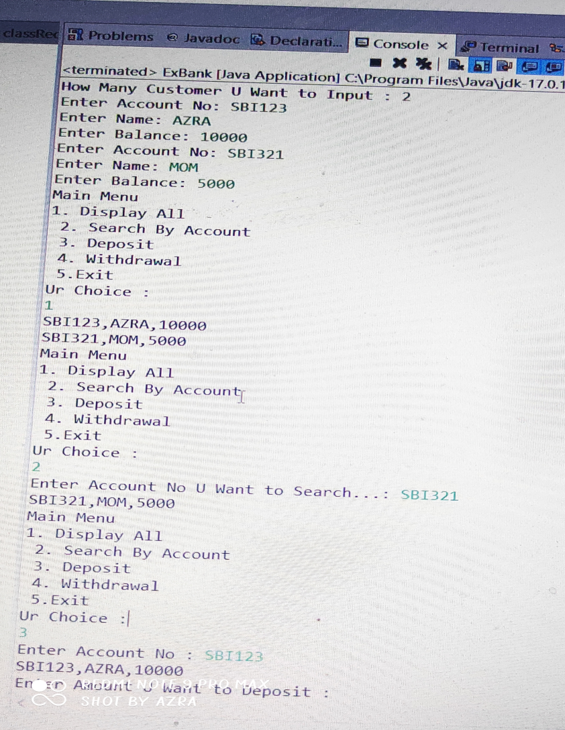
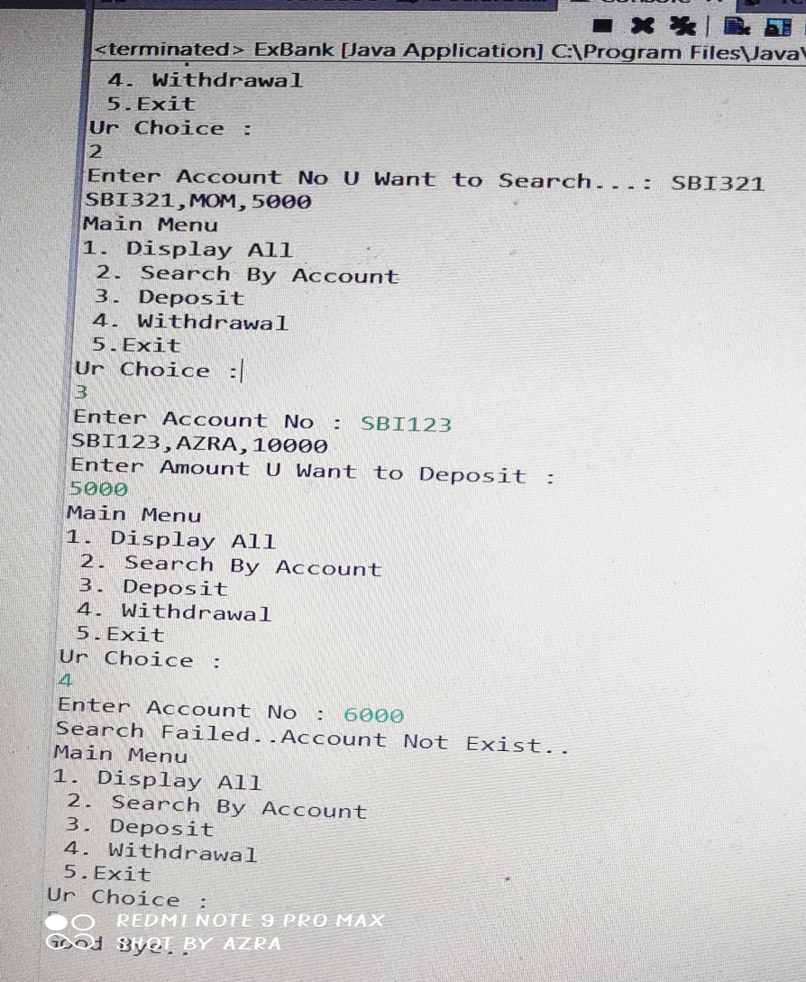
OUTPUT

Slide 6

THANK YOU

